Slide 1


ECEN 404
Bi-Weekly Update 4
Matrix 1 / “Scooter Juice”
Connor Cottongame
John Dusterhoff
Blake Hallam
Oscar Rubio
TA: Sabyasachi Gupta
Sponsor: Prof Prasad Enjeti

Slide 2

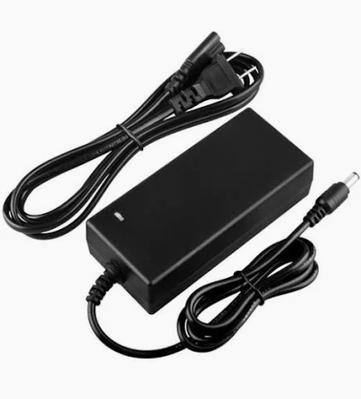

Project Summary
Problem statement:
Current electric scooter chargers are bulky and inconvenient to use, requiring large, external rectifiers to charge their batteries, much like a laptop charger.
Our Solution:
This team will design and build an IOBC (Integrated On-Board Charger), allowing the scooter to be charged directly from an AC power source.
This charger will use the existing inverter components in the scooter as a rectifier in order to charge the battery.

Slide 3
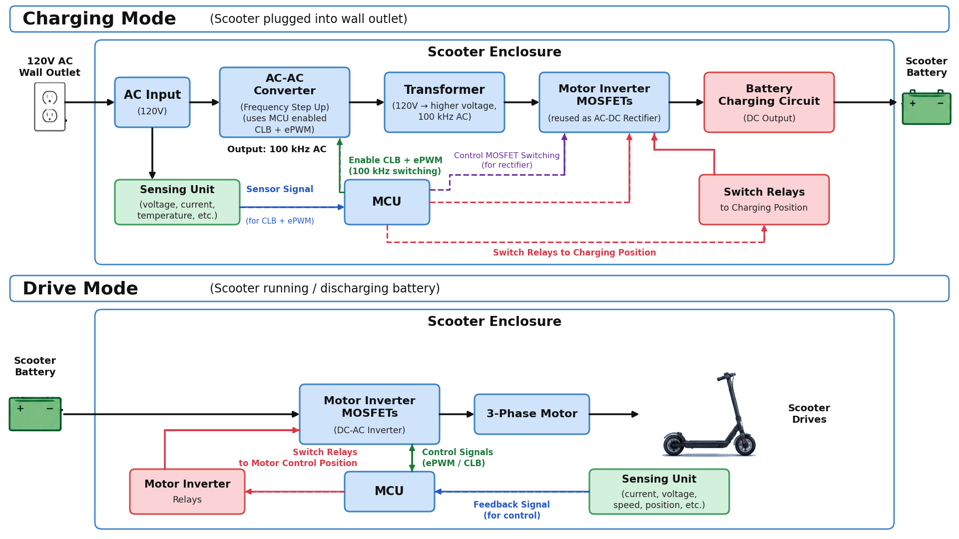
Integrated System Diagram

Slide 4
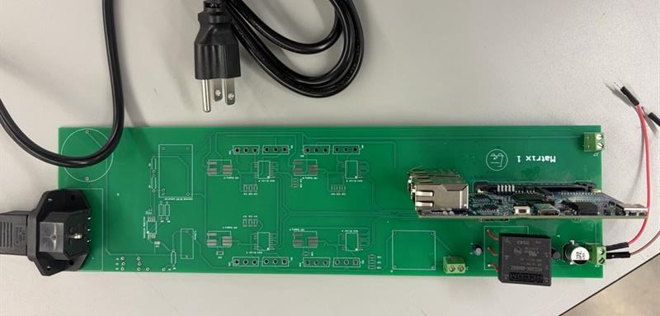
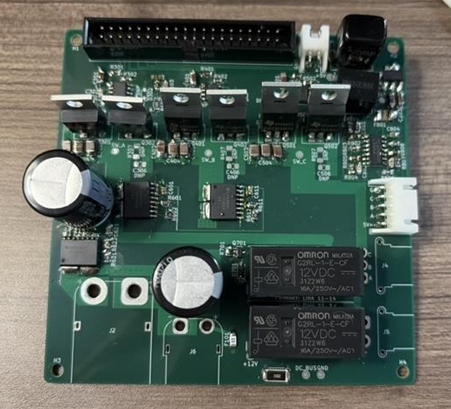
Integrated System Diagram
MCU Connection
controlCard (MCU)
Motor Control Connections
Transformer Connection
Wall Input
Matrix Converter
Transformer
MCU Connector
Battery Inputs
Battery Connections
Primary Side that has wall input connection, matrix converter, controlCard (MCU) and transformer
Secondary Side PCB that has motor relays, motor inverter for drive and charging states, and battery sensing unit

Slide 5
Project Timeline
Subsystem Designs and Updated and necessary testing (completed by 9/14) | Final subsystem testing and start integration (completed by 9/28) | Integration of MCU, signal processing and power stages (complete by 10/1) | Final Integration (to complete by 10/22) | Full System Testing (to complete by 11/5) | Full System Validation (to complete by 11/12) | Demo and Report (to complete by 12/5)

Slide 6
Signals & Power Conditioning
Blake Hallam
Accomplishments since Update #3 10 hrs of effort | Ongoing progress/problems and plans until the next presentation
Tested full matrix with Gate drivers and MOSFETs. Tested and validated circuit design. Through testing, validated the input to the transformer. | Complete the assembly of the new PCB with the components. Complete full integration with Oscar and test. If testing is successful, start integration with John and Connor.

Slide 7
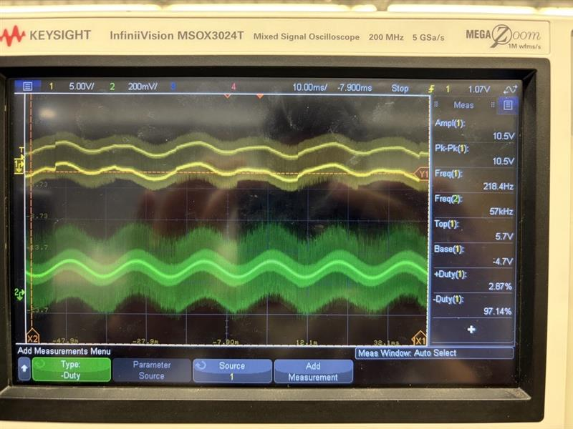
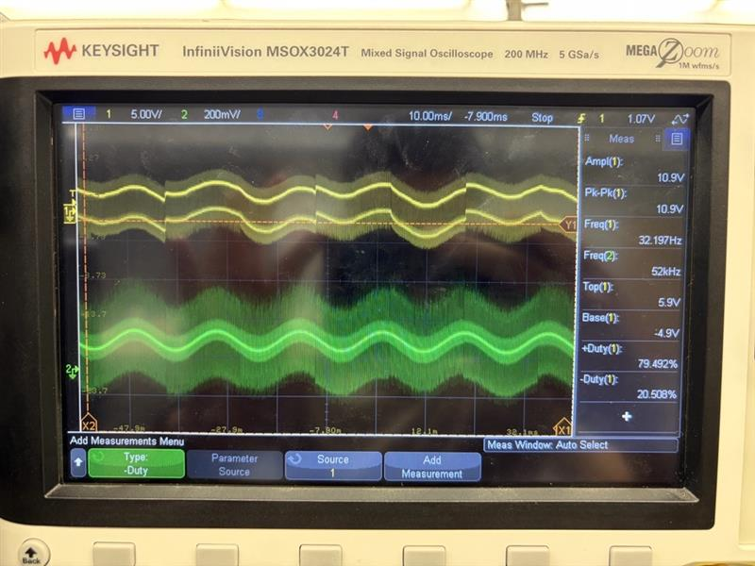
Matrix Control and Signal & Power Conditioning Integration
Blake Hallam
MOSFET Output Waveform compared to input Sine Wave for test 1
MOSFET Output Waveform compared to input Sine Wave for test 2

Slide 8
Matrix Control and Enclosure
Oscar Rubio
Accomplishments since Update #3 14 hrs of effort | Ongoing progress/problems and plans until the next presentation
Tested Full Matrix Controller with ADC input ranges Tested and Validated Output of Matrix Control Signals and the MOSFETs Flashed Firmware onto the TI C2000 controlCard | Finalize the Enclosure design once certain parts have been soldered 3D print both parts of the enclosure

Slide 9
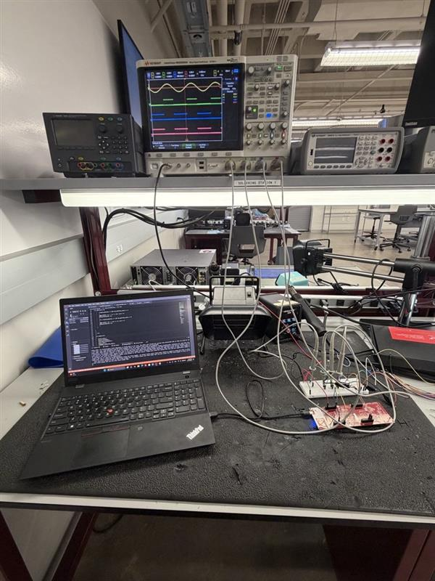
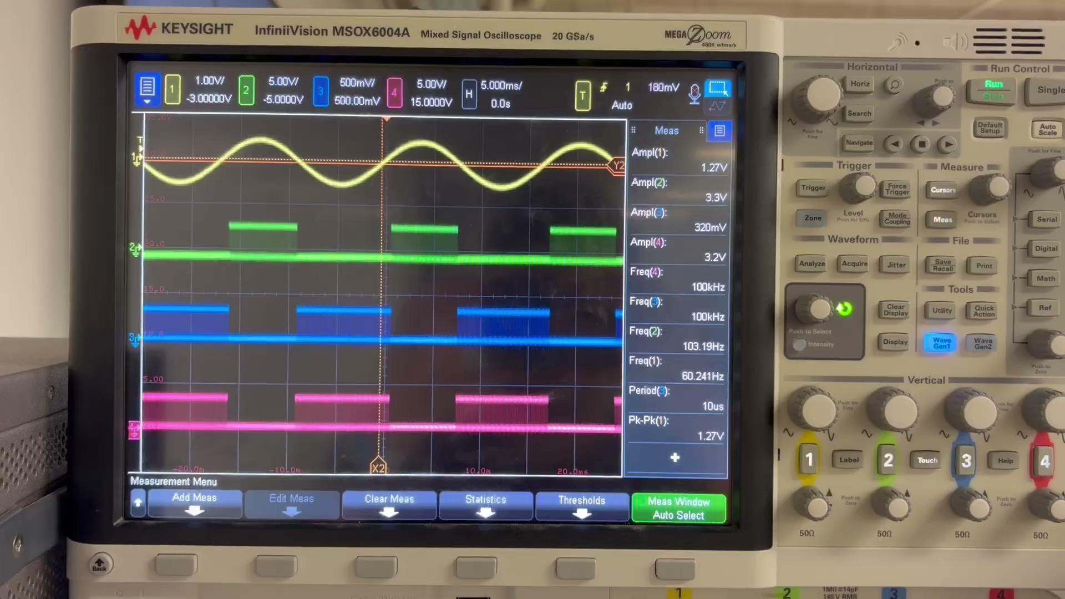
Matrix Control and Enclosure
Oscar Rubio
Testing Setup for full ADC to Control Signal Output tests
Video showing Control Signals for Matrix diagonal legs following Input Sine Wave

Slide 10
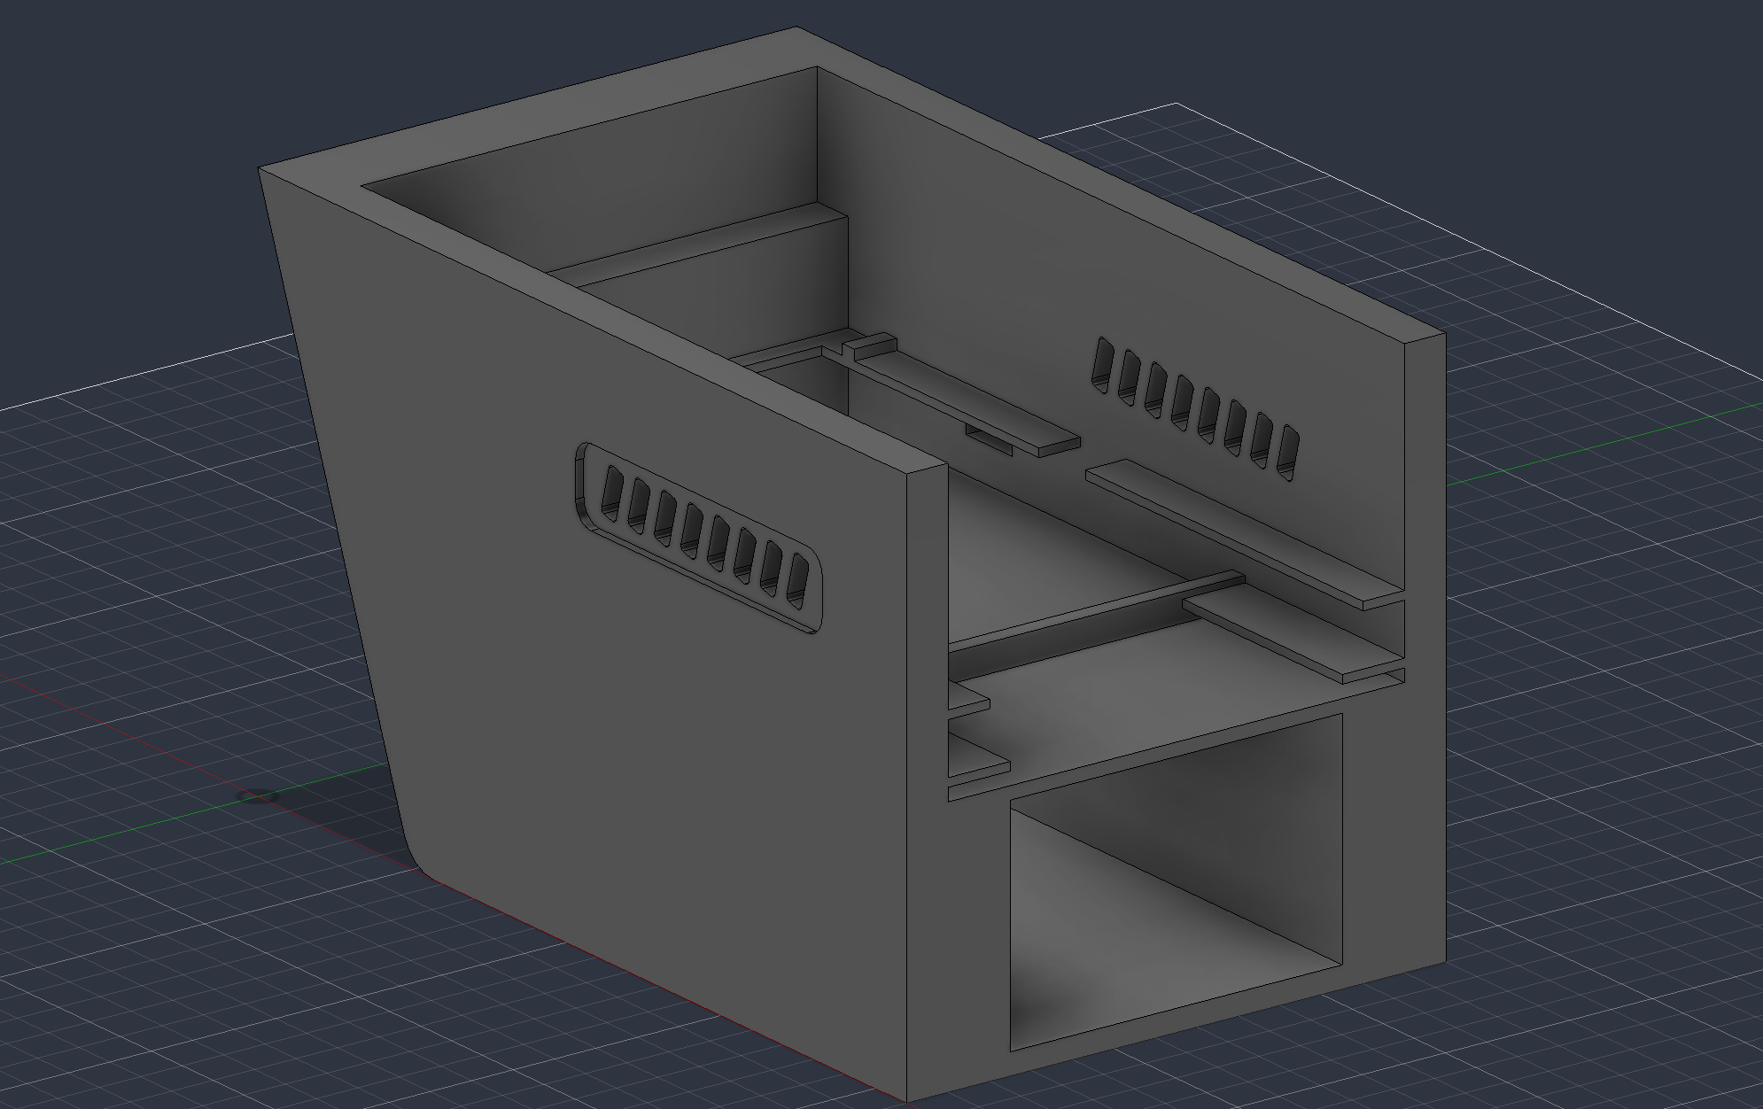
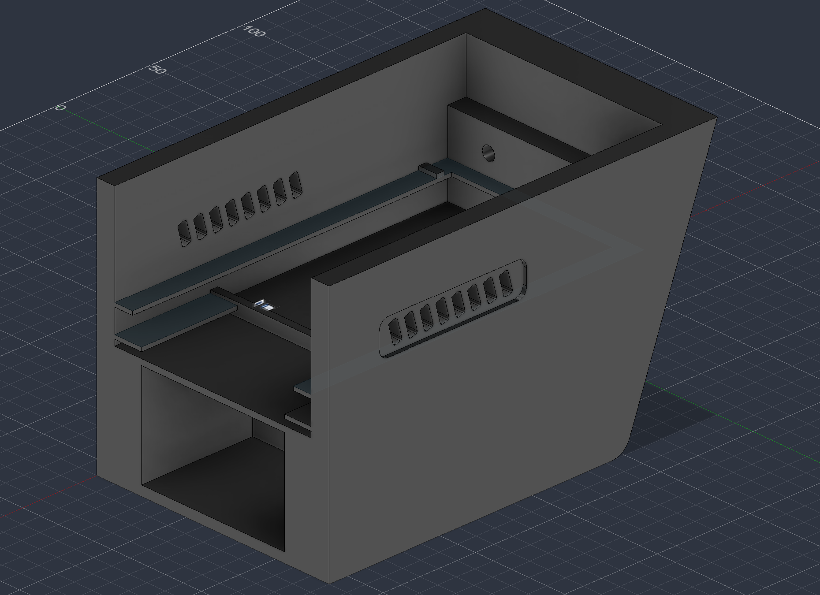
Matrix Control and Enclosure
Oscar Rubio
Enclosure Left-Hand Side
Enclosure Right-Hand Side

Slide 11
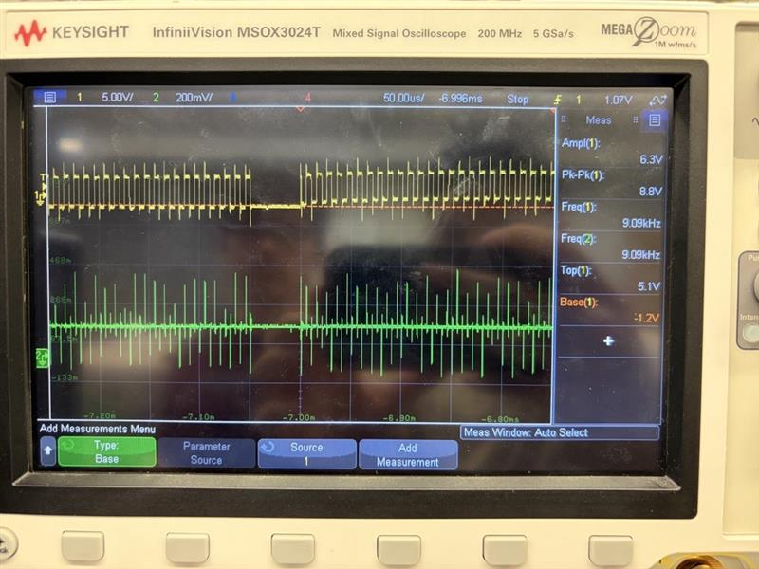
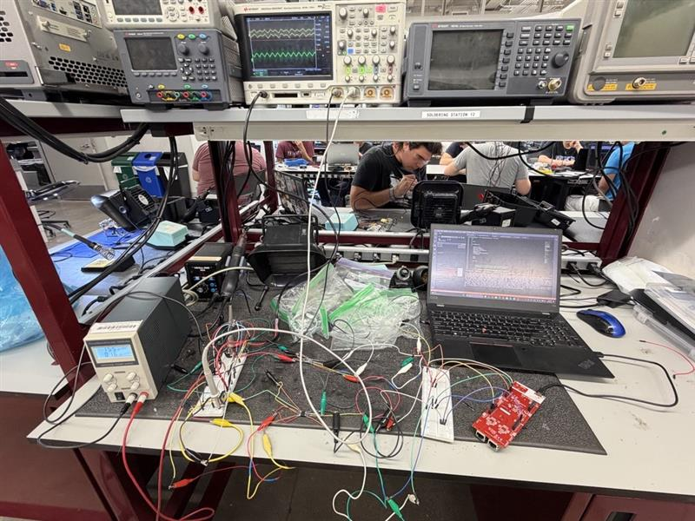
Matrix Control and Signal & Power Conditioning Integration
Oscar Rubio
Output of Control Signals and Input Wave from the MOSFETs converter
Testing Setup for full Control Signals and MOSFET converter

Slide 12
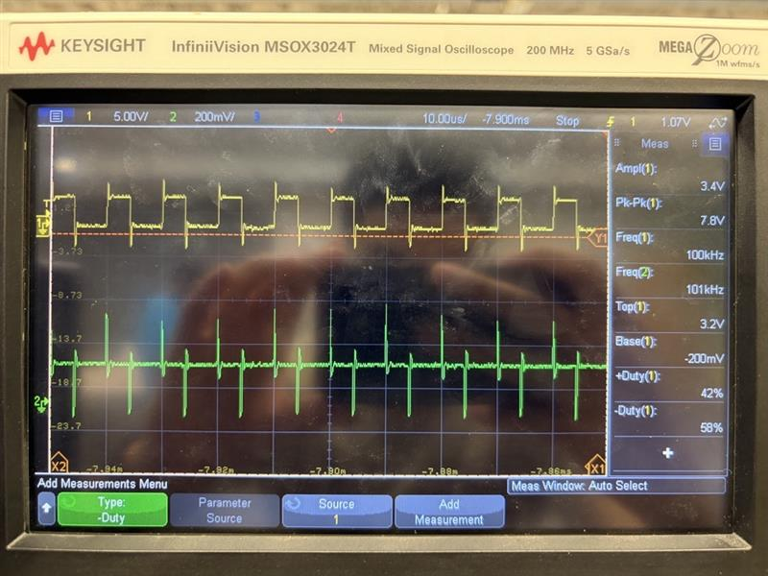
Matrix Control and Signal & Power Conditioning Integration
Oscar Rubio
Duty Cycle Input | Measured Duty Cycle Output (+) | Measured Duty Cycle Output (-) | Frequency | % Difference | Pass/Fail
50.00% | 49.90% | 50.10% | 100.19 kHz | 0.20%
42.00% | 42.00% | 58.00% | 100 kHz | 0.00%
25.00% | 25.10% | 74.90% | 100.02 kHz | 0.40%
75.00% | 76.00% | 24.00% | 100 kHz | 1.32%
63.00% | 62.80% | 27.20% | 100.04 kHz | 0.32%
9.00% | 8.93% | 91.07% | 100.05 kHz | 0.78%
33.00% | 32.92% | 67.08% | 100.1 kHz | 0.26%
Data from varying Duty Cycle Output Test
Output of 100kHz PWM Signals and MOSFETs changing with different duty cycle inputs

Slide 13
PCB Design
John Dusterhoff
Accomplishments since Update #3 14 hrs of effort | Ongoing progress/problems and plans until the next presentation
Primary PCB power system soldered Battery Testing finished 5V rail validated on bench power and battery power | Validate 15V rails on bench and battery power Validate power to controlCard Confirm controlCard signal integrity Validate total primary board input power to transformer Whole system validation

Slide 14
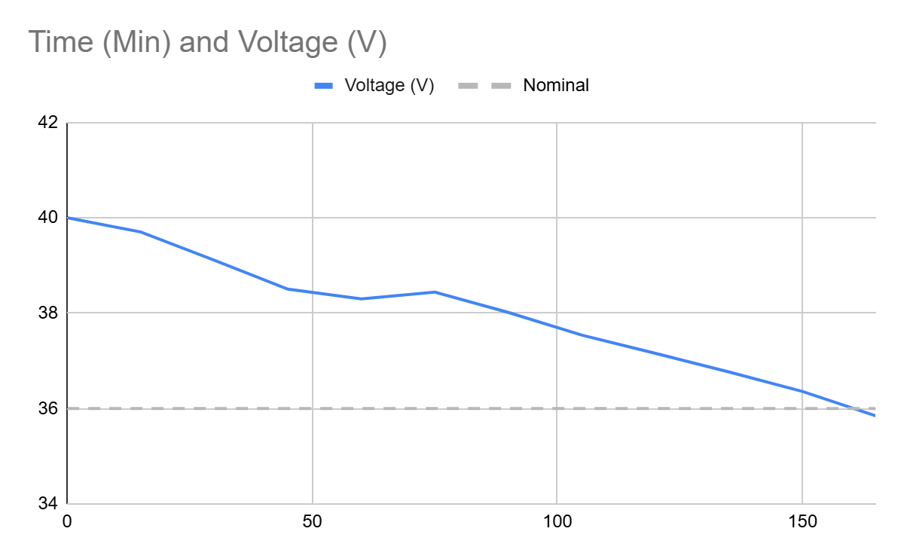
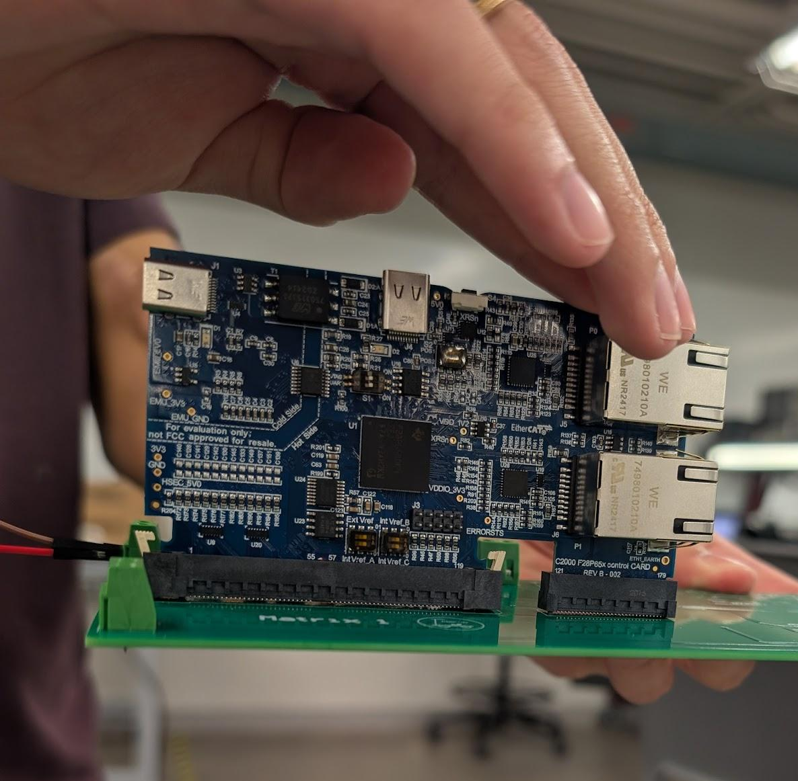
PCB Design
John Dusterhoff
Battery Charge over time, from fresh fully charged battery to dead, 1 cycle
controlCard attached to Primary PCB

Slide 15
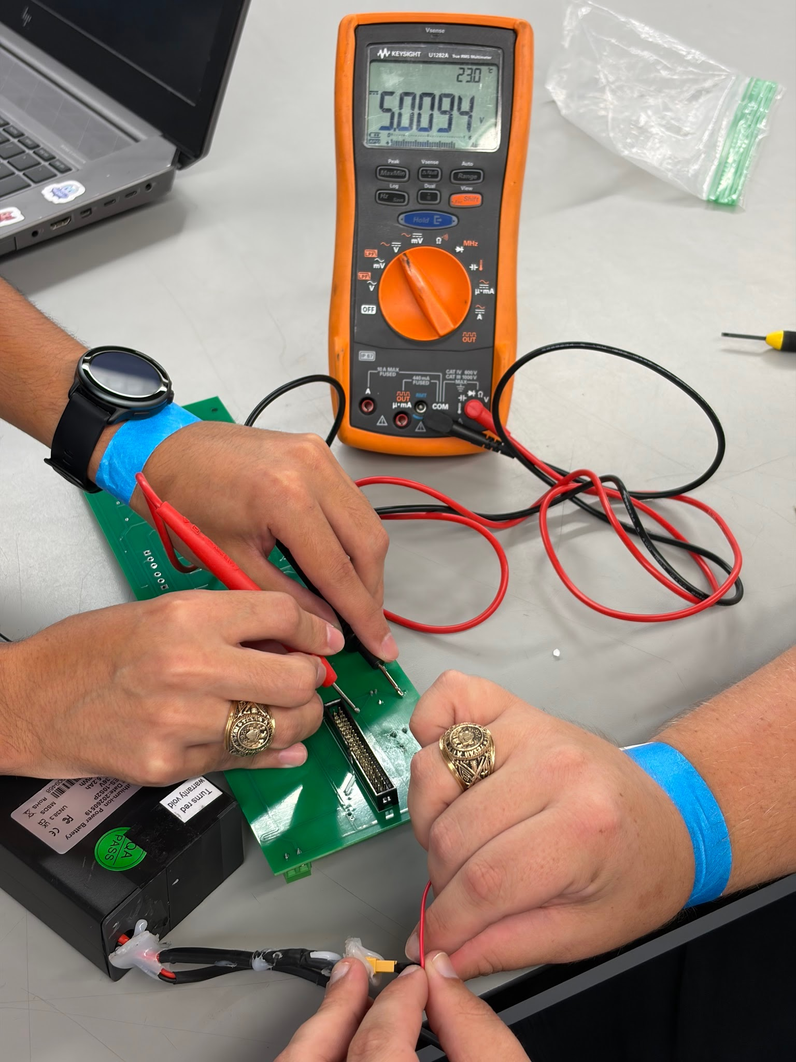
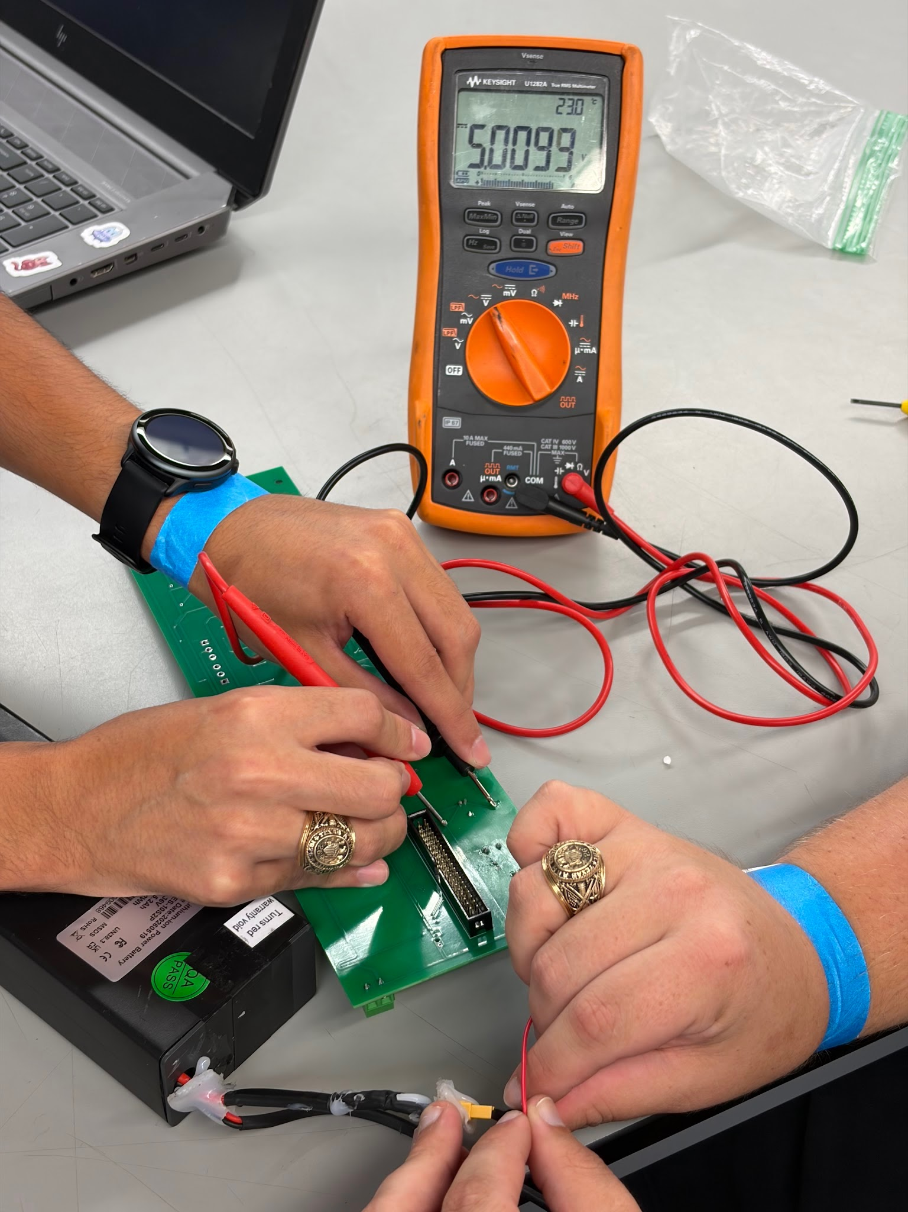
PCB Design
John Dusterhoff
5V Power Rail testing from Battery
5V Power Rail testing from Battery

Slide 16
Charging Control Software and DAB Secondary Side
Connor Cottongame
Accomplishments since Update #3 16 hrs of effort | Ongoing progress/problems and plans until the next presentation
Finished board assembly 10/14 (today) Firmware now ready for real board (untested): motor control and DAB phase shift control | Test power rails Low-voltage gate driver and half-bridge switching tests Spin motor w/ hall sensor feedback Assemble primary board and transformer + inductor for DAB testing

Slide 17
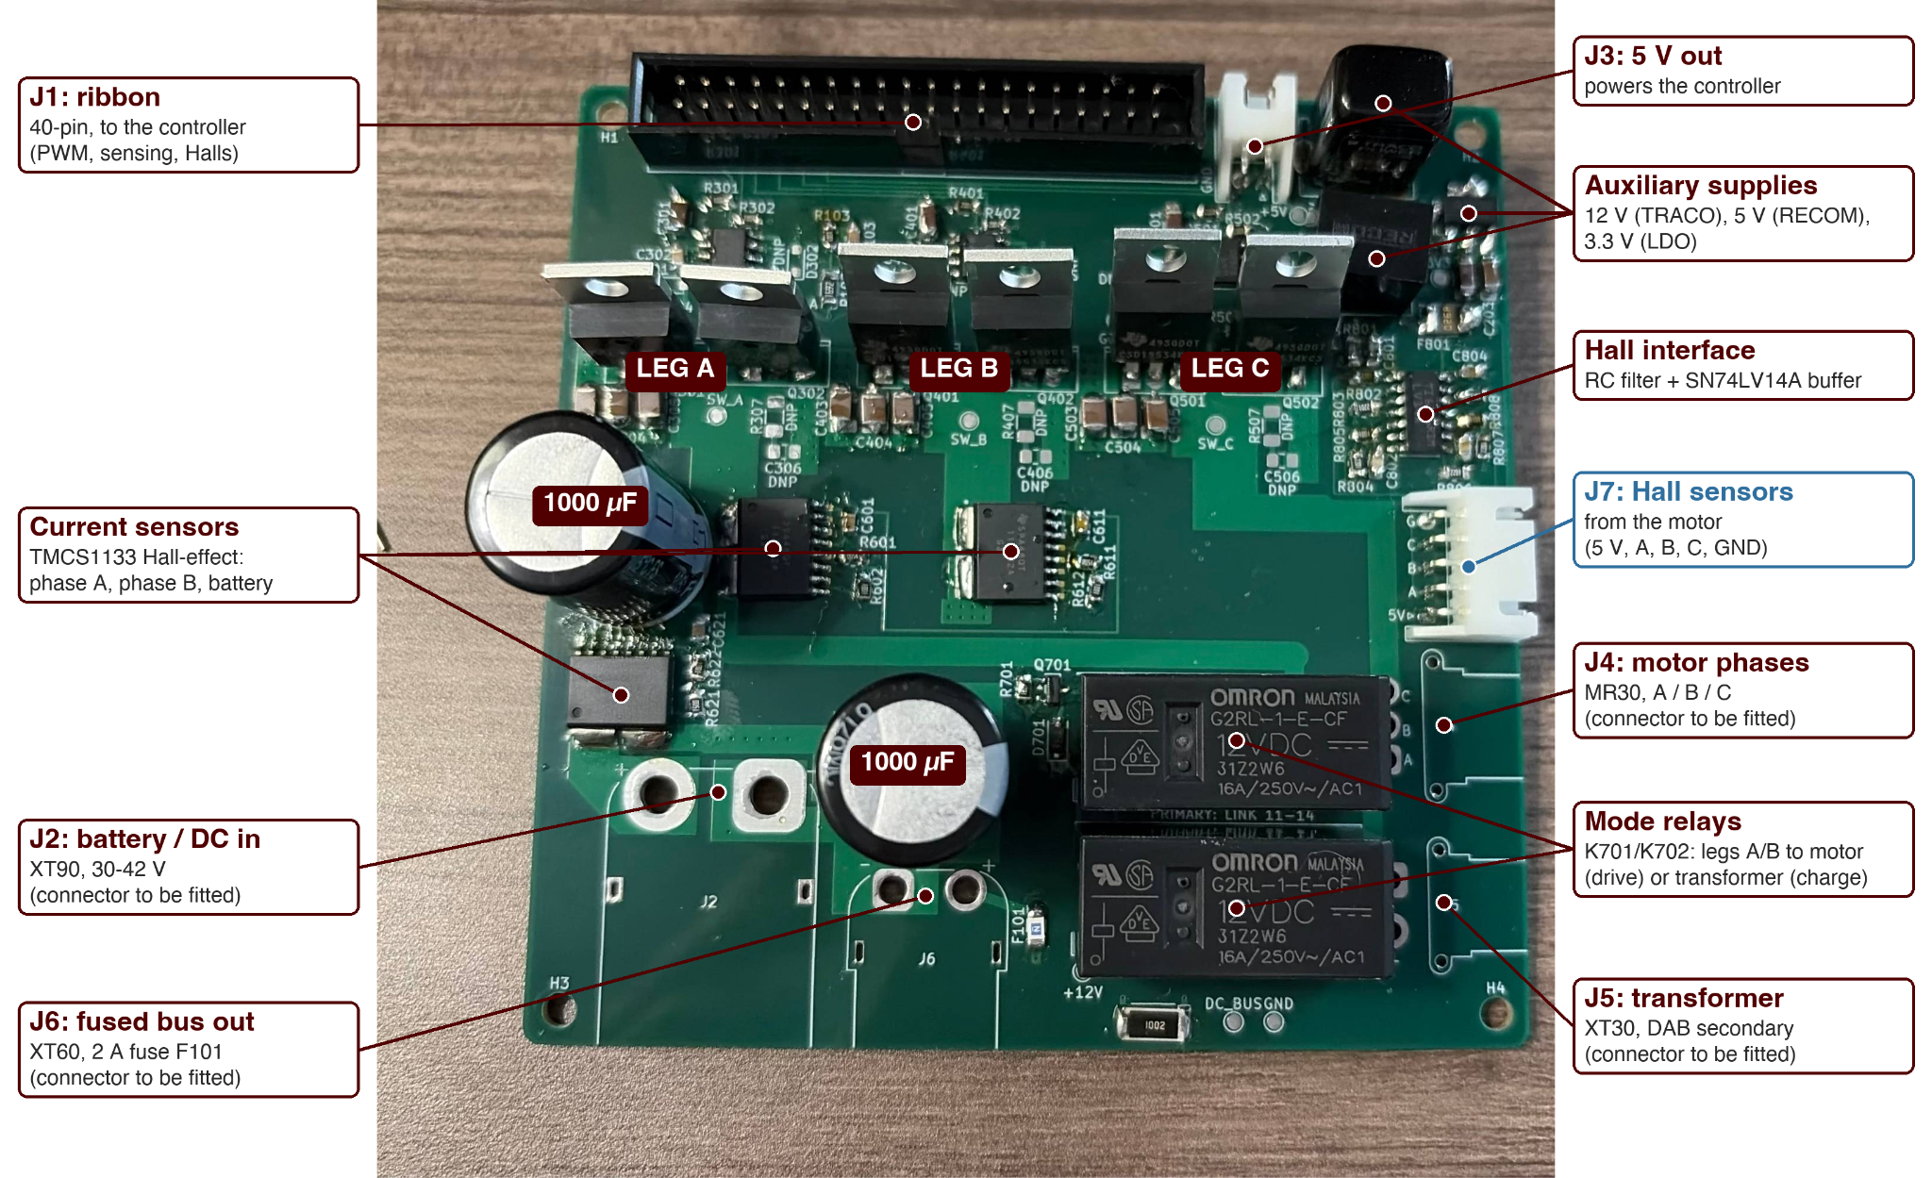
Charging Control Software and DAB Secondary Side
Connor Cottongame

Slide 18
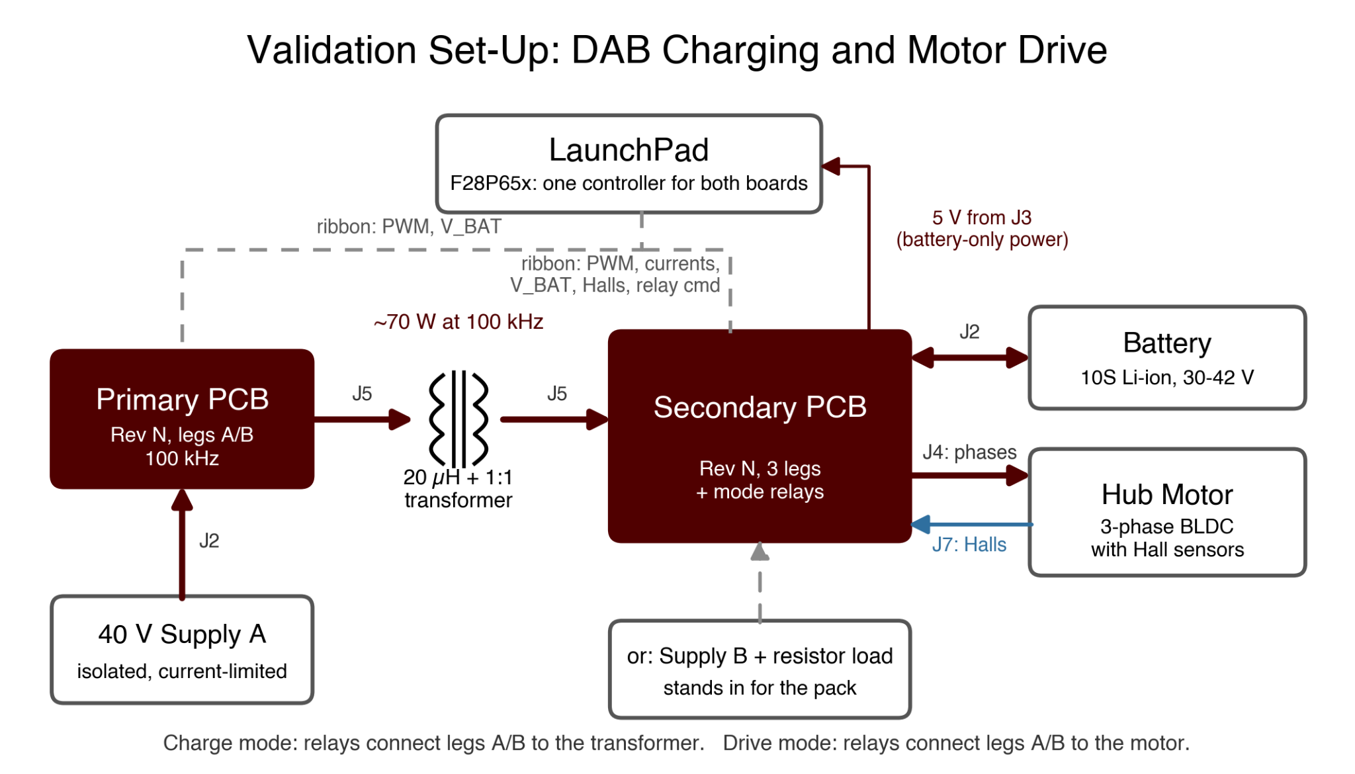
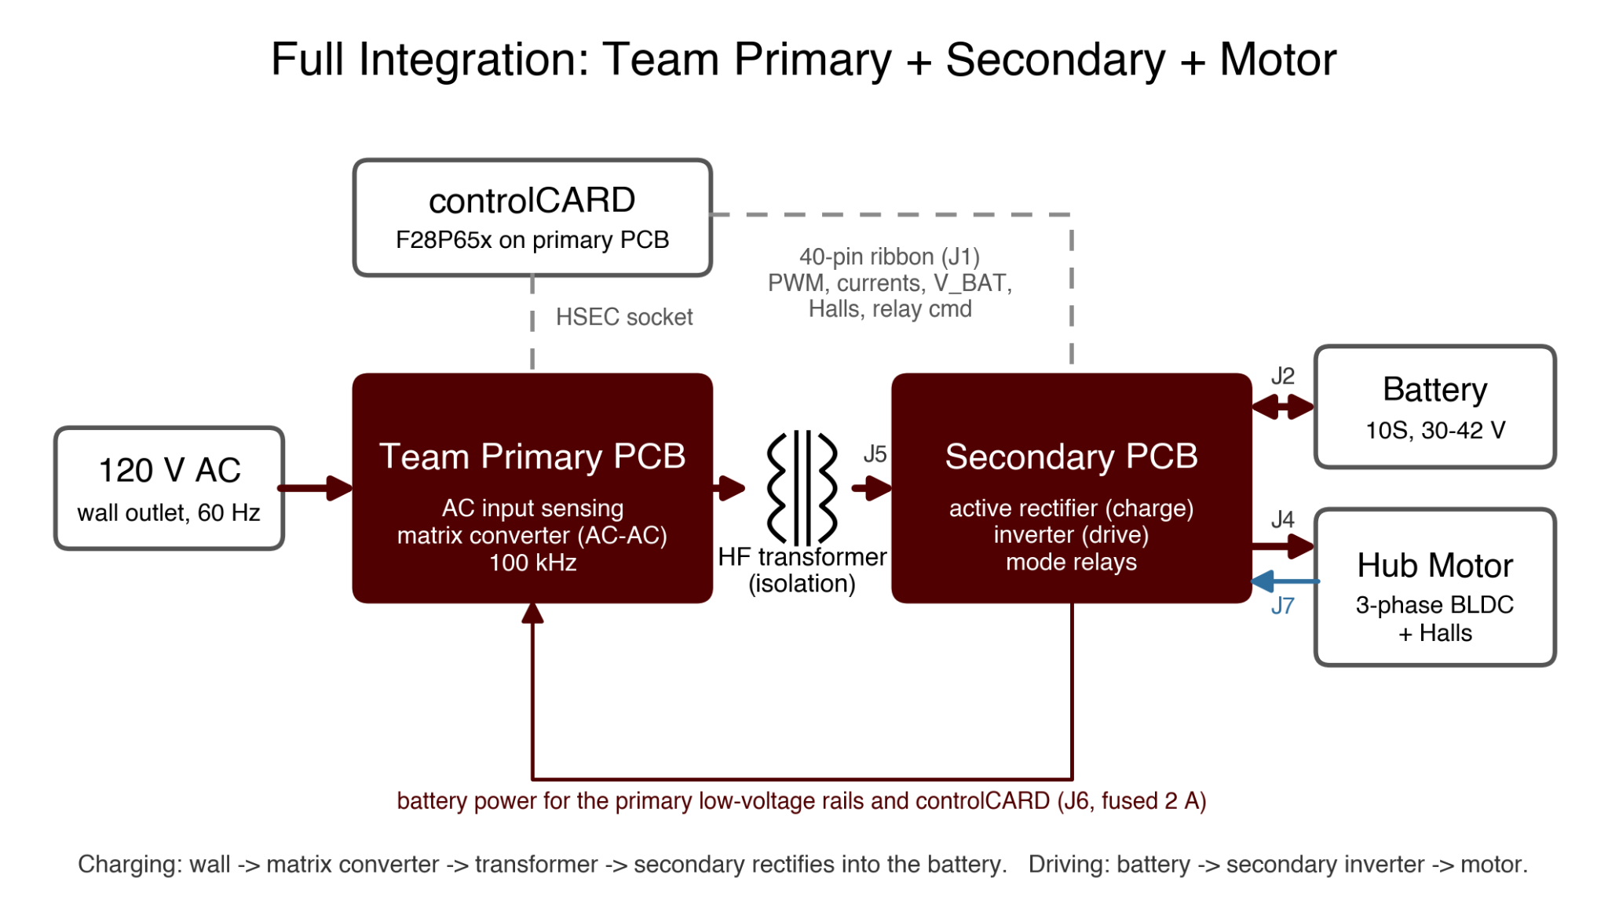
Charging Control Software and DAB Secondary Side
Connor Cottongame

Slide 19
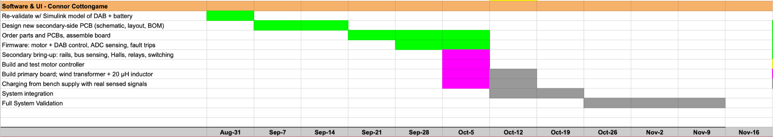
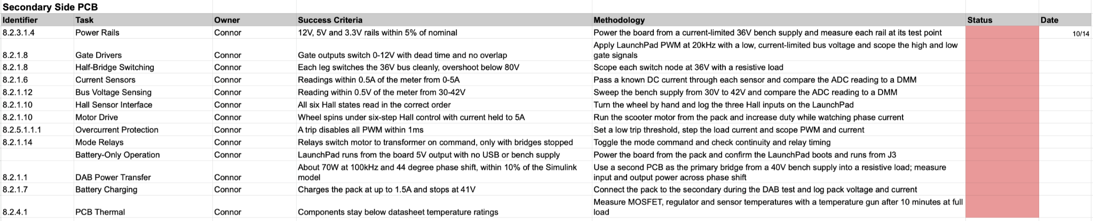
Execution & Validation Plans

Slide 20
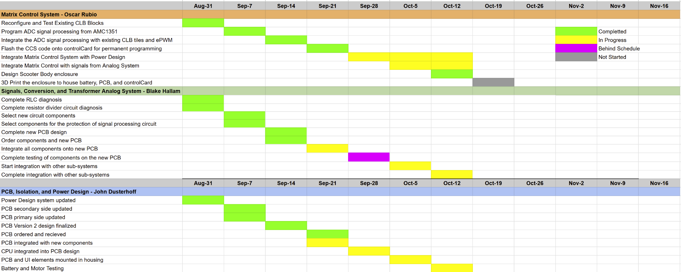
Execution Plan

Slide 21
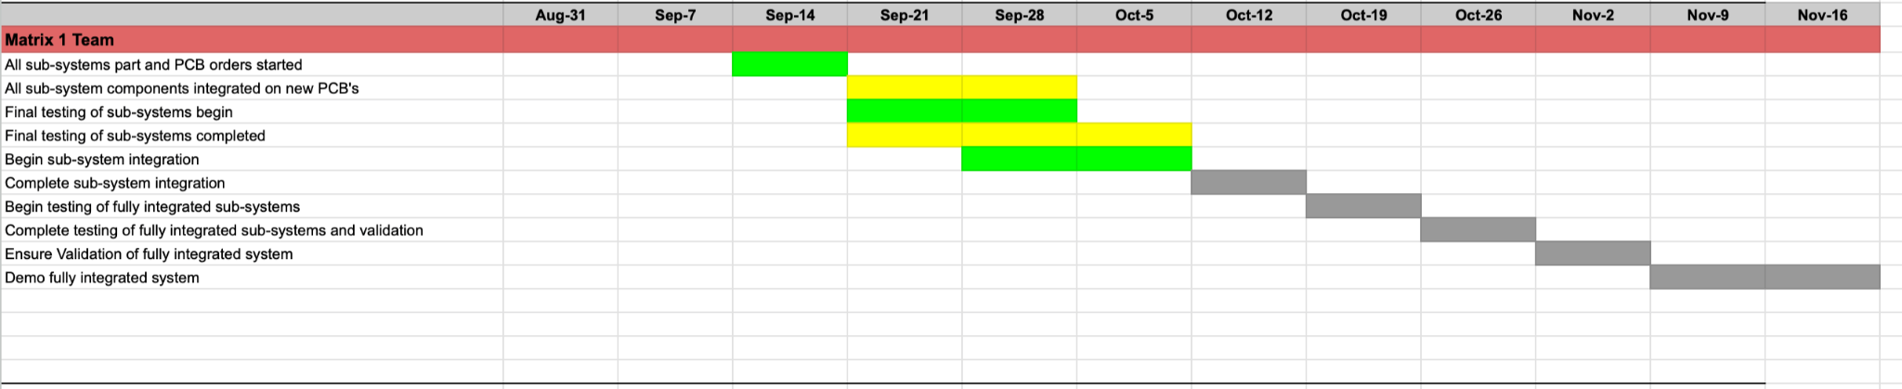
Execution Plan

Slide 22
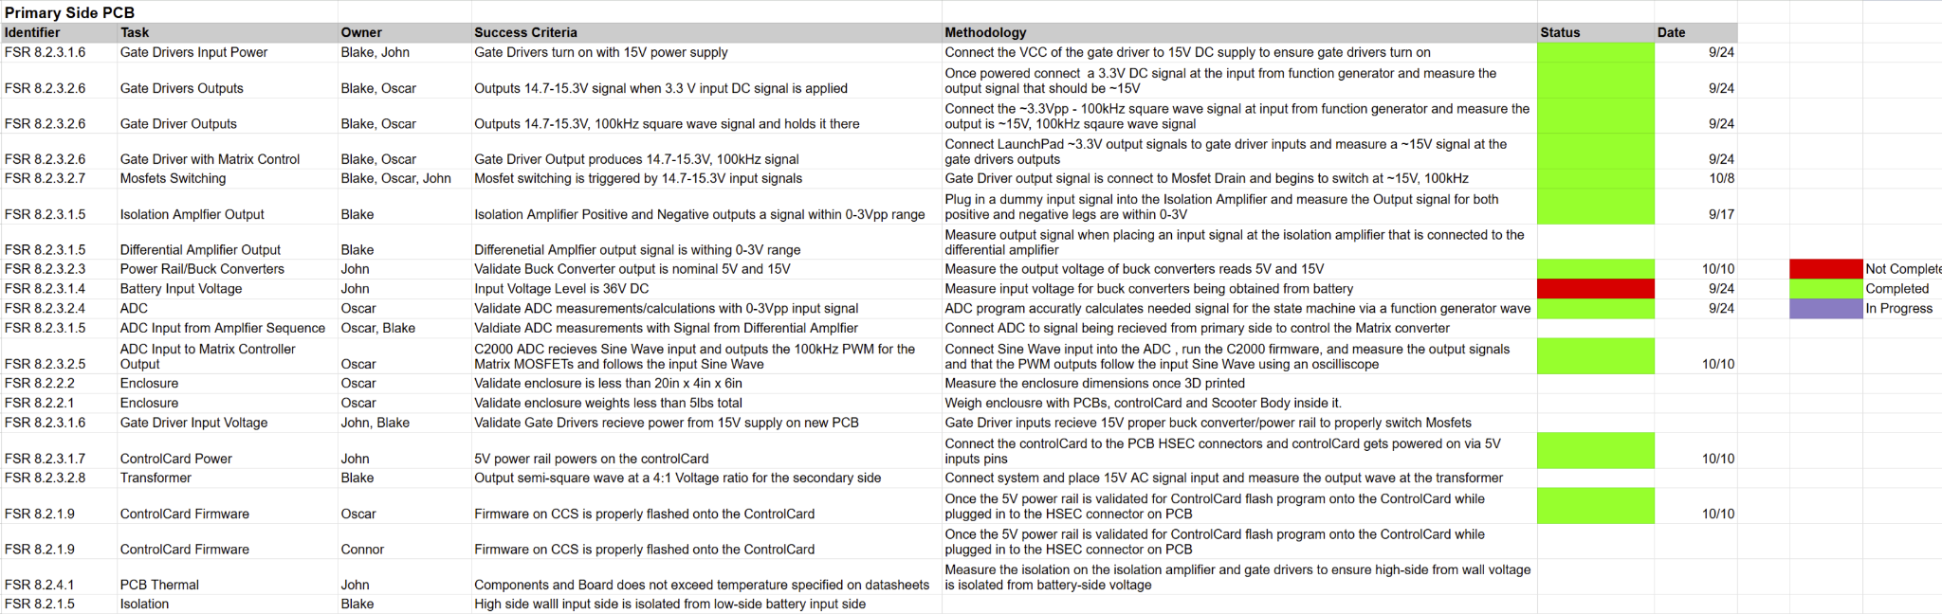
System Validation Plan

Slide 23
Thank You For Your Time and Attention
Any Questions?
Matrix 1 / “Scooter Juice”
Connor Cottongame
John Dusterhoff
Blake Hallam
Oscar Rubio
TA: Sabyasachi Gupta
Sponsor: Prof Prasad Enjeti

